Slide 1

ROBOTIC AUTOMATED EXTERNAL DEFIBRILLATOR AMBULANCE FOR EMERGENCY MEDICAL SERVICE IN SMART CITIES
GUIDE :
Mr. C.THIYAGARAJAN
ASSISTANT PROESSOR,
DEPARTMENT OF CSE,
PANIMALAR ENGINEERING COLLEGE
SUBMITTED BY:
DINESH K R (211417104054)
HAZARATH SHRAVAN M R (211417104084)
FAZIL M (211417104063)

Slide 2
INTRODUCTION
Traffic signals in India has a fixed time period to switch the signals. No changes for emergency vehicles.
This makes the patient in ambulance to sever stage. To deal with this problem we designed this system.
In this paper, we propose an IOT-based system for patients with the risk of heart attack and uneven body temperature, high pulse rate.
If the condition is critical an alert notification will be sent to the hospital monitoring database.
This system consists of various sensors which collects the patient's information and transmit those information to the server via IOT board.

Slide 3
LITERATURE SURVEY
Heading | DESCRIPTION
Development of Monitoring and Health Service Information System to Support Smart Health on Android Platform(2018) | This research proposes a design of health monitoring system named Mooble ,a system to monitor patient health condition and to prevent diseases as early as possible. Mooble consists of three subsystems: web application, database and API design, and mobile application on android platform.
An Android Application for Geolocation Based Health Monitoring, Consultancy and Alarm System (2018) | In this study they benefit the facilities provided by mobile technology and propose a geolocation-based heart rate monitoring system.
Remote health, activity, and asset monitoring with wireless sensor networks(2017) | They propose a system that employs a wireless mesh sensor network to provide the communication backbone for stationary and wearable sensors.

Slide 4
PROBLEM STATEMENT
The traffic condition in India effect emergency services like Ambulance and Fire engine. Time is an important factor in case of emergencies; hence we are proposing a system which makes the patient gets right time treatment in ambulance.
According to research conducted by global consultancy firm, traffic in peak hours in major four cities - Delhi, Bengaluru, Chennai, Kolkata costs the economy Rs 1.47 lakh crore per annum
Because of this delay in ambulance service, patient may lose his life and number of these scenarios are increasing day by day.
When emergency vehicles are stuck in heavy traffic and cars are unable to pull over. In that time, the patients gets into dangerous stage. In ambulance the care taker have no idea treat the patient in sever stage it makes patient die or dangerous stage.This paper proposes a solution to make such services easily available to those in need.

Slide 5
TECHNOLOGY STACK
Software:
KEIL UVISION
EMBEDDED C
Hardware:
ATMEL Microcontroller
ECG Sensor, IR Sensor, HeartBeat Sensor
Global Positioning System (GPS)
Global System for Mobile Communication (GSM Module)
Liquid Crystal Display (LCD)
Relay

Slide 6
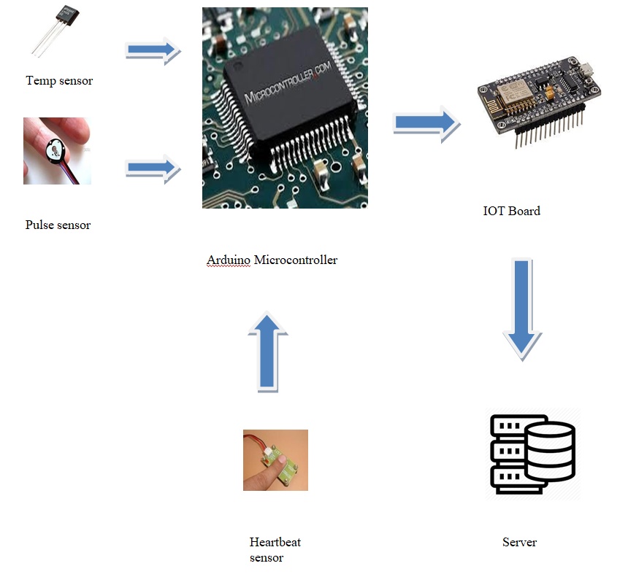
SYSTEM ARCHITECTURE

Slide 7
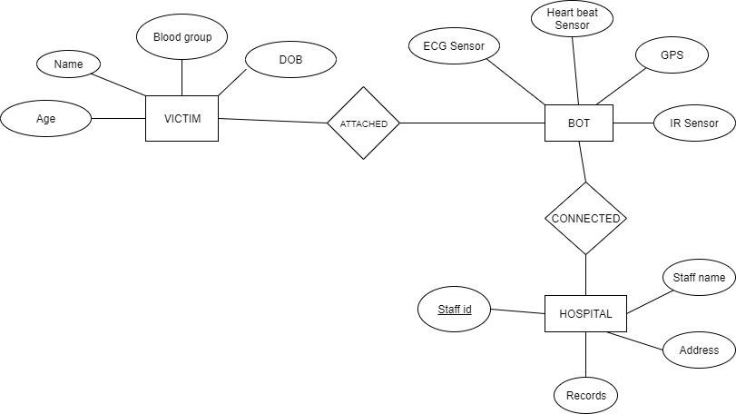
SYSTEM DESIGN
ER Diagram

Slide 8
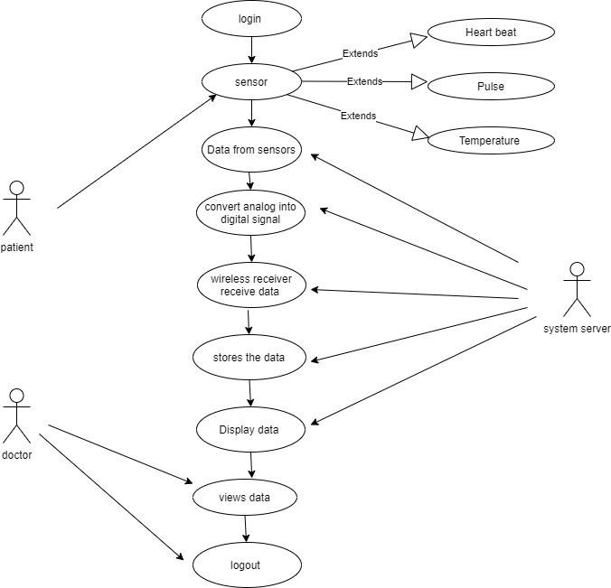
UseCase Diagram

Slide 9
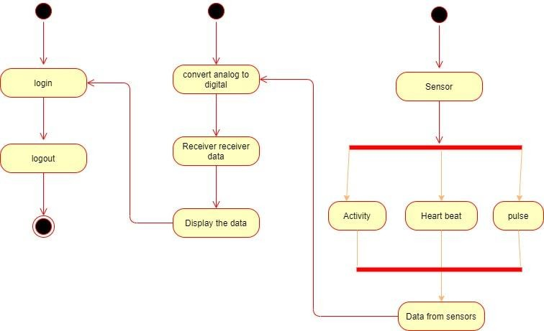
Activity Diagram

Slide 10
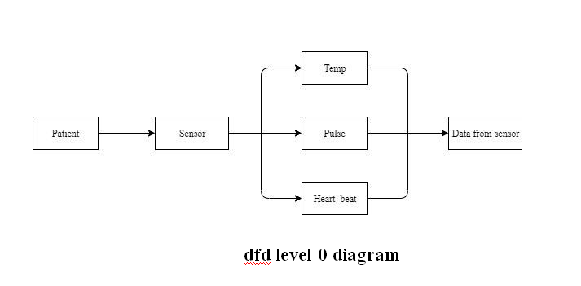
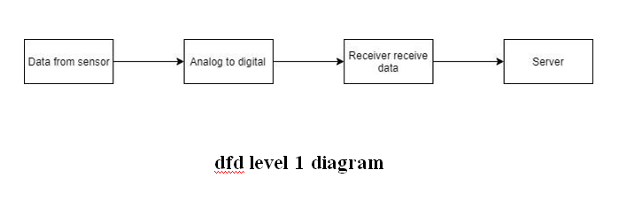
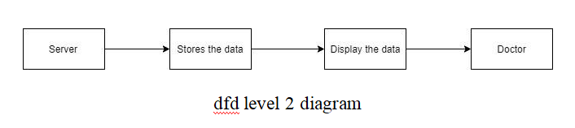
DFD Diagram

Slide 11
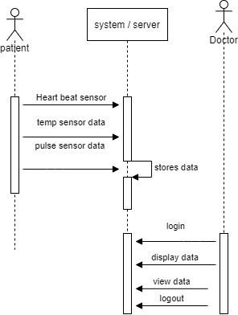
Sequence Diagram

Slide 12
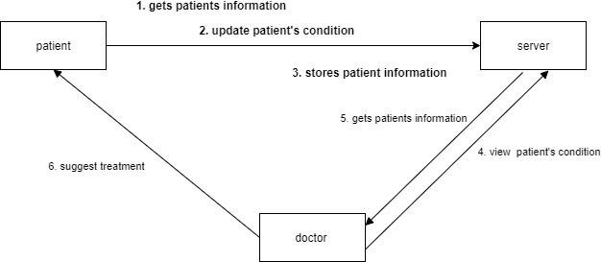
Collaboration Diagram

Slide 13
MODULE DESCRIPTION
Data Collection from patient’s by using sensor :
Sensor is a devices to measure temperature, pulse, heart beat readings through electrical signals.
Temperature is the most common physical measurement type in industrial applications.
Pulse sensors use the photoelectric method.
The heart rate sensor measures your heart rate in Beats per Minute using an optical LED light source and an LED light sensor.
The sensor will get the information of patient’s temperature, pulse, heartbeat and transmit it into microcontroller.

Slide 14
Transmit data from ardunio to IOT board by use of UART protocol :
Microcontrollers can take inputs from the device they controlling and retain control by sending the device signals to different parts of the device.
Microcontroller will transmit data from arduino to IOT board by using UART protocol.
It provides transmit data and a receive data and then send it to the server.
And it will be stored in server and display that information to the doctor.

Slide 15
Transmit data from IOT board to server by use of MQQT protocol :
IOT board will transmit the data to server by use of MQQT protocol.
IoT prototyping kits and development boards combine microcontrollers and processors.
MQ Telemetry Transport is an extremely simple and lightweight messaging protocol (subscribe and publish) designed for limited devices and networks with high latency, low bandwidth or unreliable networks. By using the data received from controller the doctor can suggest the treatment to the patient.
As it reduces the human effort then it definitely saves out time.

Slide 16
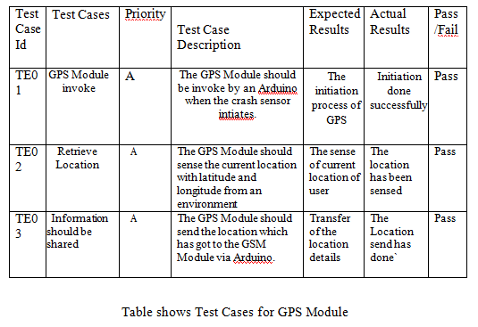
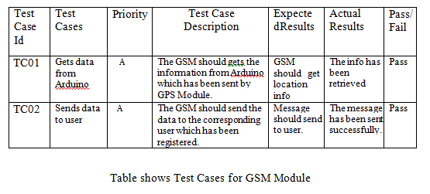
PERFORMANCE EVALUATION
TestCases For GPS and GSM Module

Slide 17
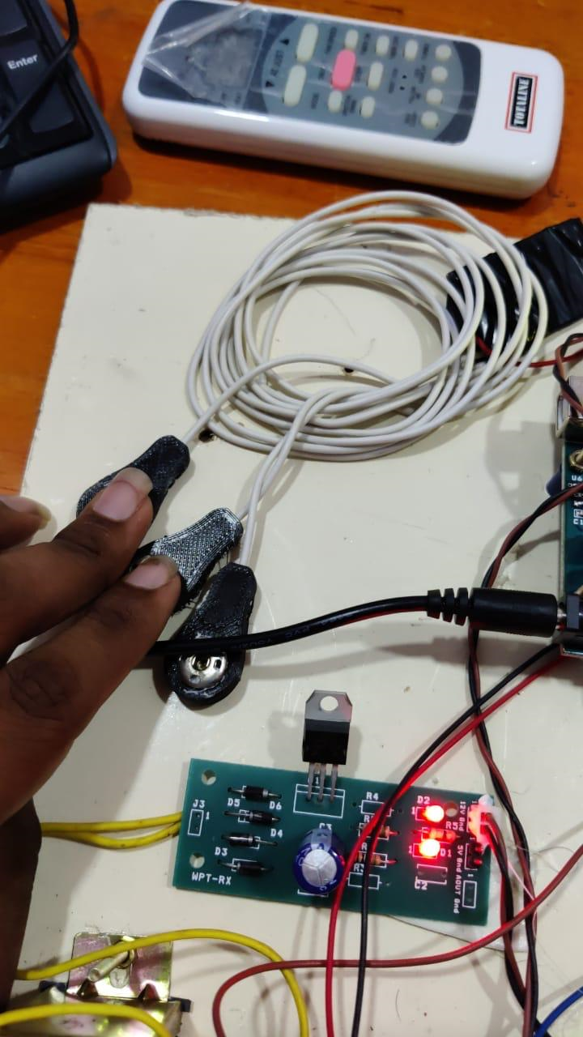
SCREENSHOTS
ECG Sensor

Slide 18
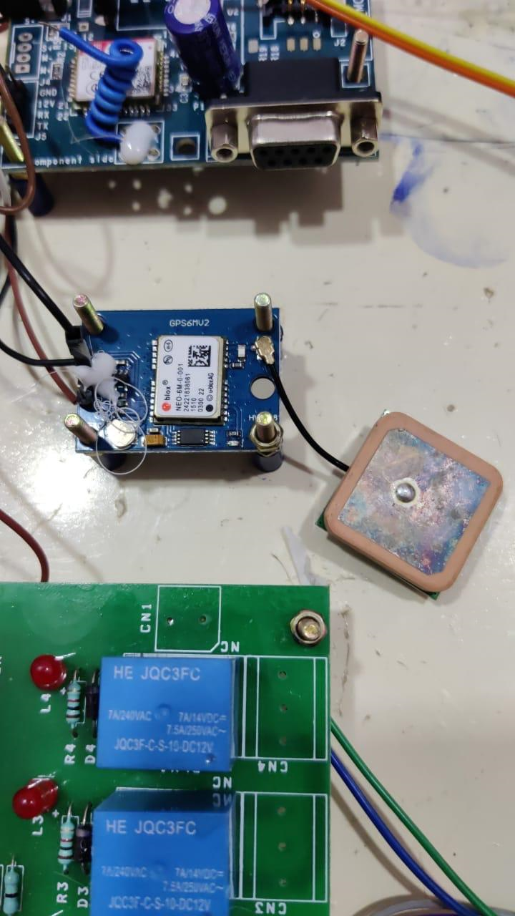
GPRS

Slide 19
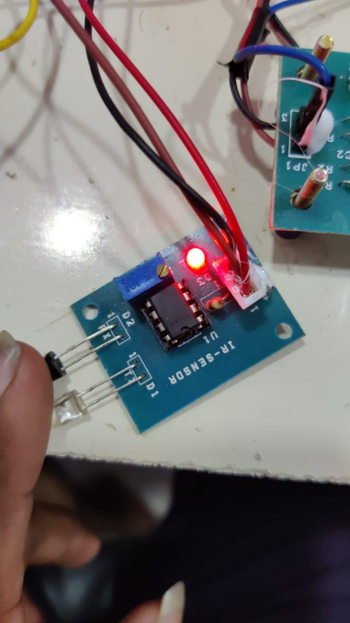
IR Sensor

Slide 20
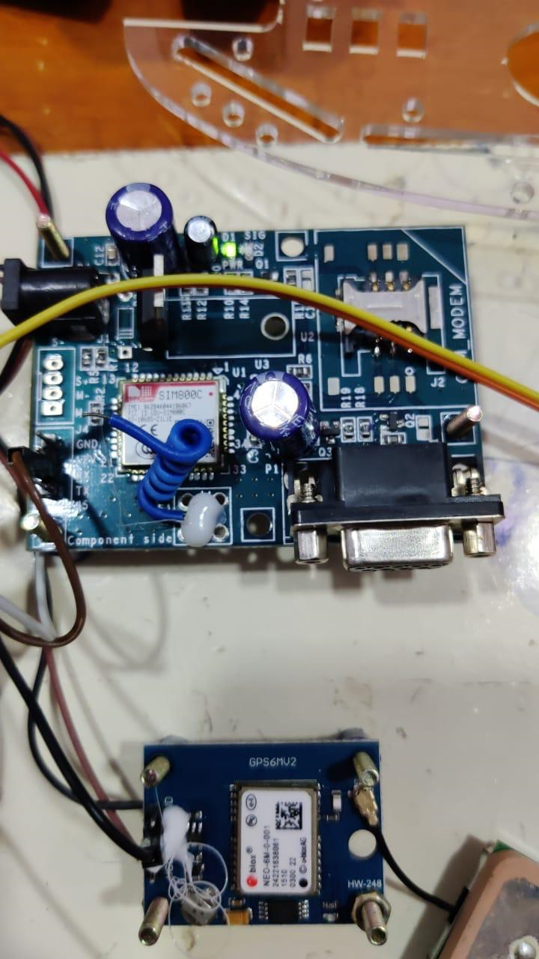
GSM

Slide 21
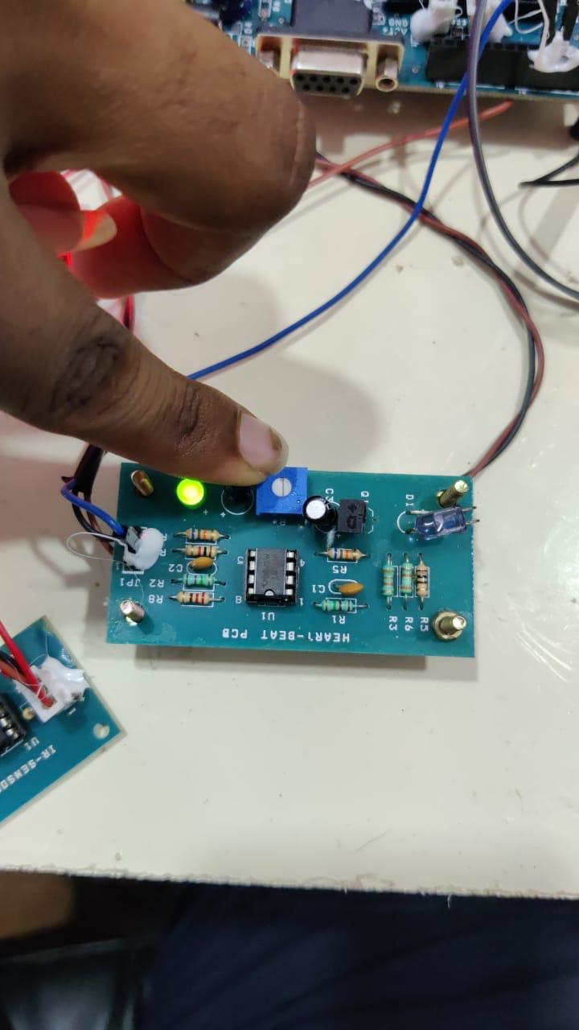
HeartBeat Sensor

Slide 22
CONCLUSION
In this paper, we propose an IOT-based system for patients with the risk of heart attack and uneven body temperature or any other sever condition in ambulance. If the condition is critical the information about the patient will be sent to the hospital database. This paper proposes a system to update patient data to hospital servers for analyzing. The doctor can view patient details, before the patient entering in to the hospital. We approach a system which is used to connect the ambulance and hospitals.
FUTURE ENHANCEMENT
Our future work will be integrated with aadhar card and patients details. It will help to doctors to analyze the doctor for past history of the patients. The processes will include the creating a data base for every patients.

Slide 23
REFERENCES
[1] H. Ning et al.,“From Internet to smart world,” IEEE Access, vol. 3, pp. 1994-1999, Oct. 2015..
[2] R. Jalali, K.El-khatib, and C. McGregor, “Smart city architecture for community level services through the Internet of Things,” in Proc. IEEE 18th Int. Conf. Intell.Next Generat. Netw. (ICIN), Feb. 2015, pp. 108-113
[3] M. Arif, H.Samani, C.-Y. Yang, and Y.-Y. Chen, “Adaptation of mobile robots to intelligent vehicles,” in Software Engineering and Service Science (ICSESS), 2013 4th IEEE International Conference on. IEEE,2013.
[4] F. Matsuno and S. Tadokoro, “Rescue robots and systems in japan in Robotics and Biomimetics, 2004. ROBIO 2004. IEEE International Conference on. IEEE, 2004.
[5] C.-P. Lam, C.-T. Chou, K.-H. Chiang and L.-C.Fu, “Human-centered robot navigation towards a harmoniously human–robot coexisting environment, ”Robotics, IEEE Transactions on, vol. 27, no. 1, pp. 99– 112,2011.

Slide 24


Thank You!

